Slide 1



Finding the Right School, Program, and Scholarship

Slide 2
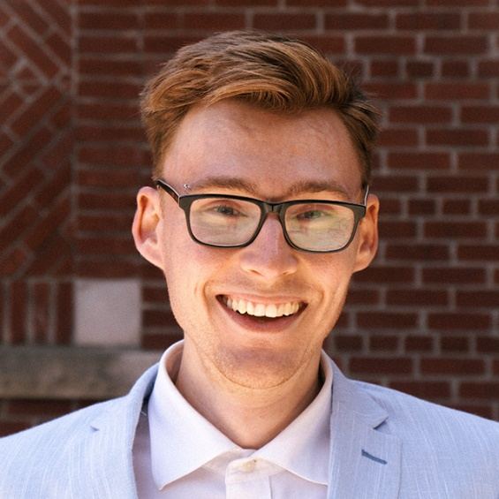
Hi!
My name is Logan Bright and I’m the Managing Editor at SchoolFinder.com and ScholarshipsCanada.com.
After high school, I got an advanced technical diploma in film production from Niagara College and worked as a video editor for several years.
Still, I always wanted to make my living with words, so I earned an honours BA in linguistics, writing, and rhetoric, from the University of Toronto.
Talk about tuition fees!

Slide 3
Getting an education is about more than money
Graduates of higher education are more environmentally conscious, have healthier habits, and have a higher level of civic participation.
In short, higher education institutions prepare individuals not only by providing them with adequate and relevant job skills, but also by preparing them to be active members of their communities and societies.
Source: https://www.worldbank.org/en/topic/tertiaryeducation
Source: https://www12.statcan.gc.ca/census-recensement/2016/as-sa/98-200-x/2016024/98-200-x2016024-eng.cfm

Slide 4
Definitions: Schools
University: big institution, usually focused on bachelor degrees, often called “college” in the United States. Typically publicly funded
College: smaller schools, usually focused on diplomas and trades certificates, often called “community college” in the United States. Publicly funded
Career college: small schools, may work with a larger college or university as a partner. Focused on short programs for career readiness. Privately funded
Grad school: part of a university, focused on professional programs

Slide 5
Definitions: Programs
Undergraduate: programs for students out of high school. Usually diploma or bachelor level
Graduate degree: further education for students who have completed undergrad, at the master or even PhD level. Think law school, med school, teacher’s college
Co-op / internship: work-integrated learning; get paid to work while you study and develop your career skills
Apprenticeship: a stepping stone to education in the skilled trades. Think plumber, electrician, welder

Slide 6
The Career Quiz
The Career Quiz was created by Rodger Harp, an accomplished
career counsellor who has helped thousands of students across Canada
with his books on careers and life skills.
https://www.schoolfinder.com/Careers/CareerQuiz/CareerQuiz.aspx

Slide 7
Your matching schools
Get a list of schools that fit you:
Check profiles
Tick the box & submit to request info
Schools will reach out to you directly
https://www.schoolfinder.com/MyAccount/MyRequest.aspx

Slide 8
Your matching programs
Find a list of programs to explore:
Sort by important factors
Check out each program listing separately
Choose programs to compare directly
Save your faves!
https://www.schoolfinder.com/MyAccount/MyMatchingProgram.aspx

Slide 9
Updating your profile
By editing your profile, you can explore alternative results.
You may find something you didn’t expect! Try:
Program field (favouring “general” fields)
Location of study
Degree level of interest
https://www.schoolfinder.com/v2Signin/BasicInformation.aspx?Action=Update

Slide 10
Events & Chatting with Students
Connect with the schools that interest you via events,
either online or in-person. Take live or virtual campus tours, too!
Find events and tours on the SchoolFinder events page
or the school’s website.
https://www.schoolfinder.com/Events/Index.aspx
https://www.schoolfinder.com/Schools/Virtual-Tours.aspx
Go even further by contacting current students to learn about their experiences. Tools like Unibuddy let you connect easily, just like social media — without sharing private information.
https://www.schoolfinder.com/Schools/Chat-With-Students.aspx

Slide 11

Study and Go Abroad /
SchoolFinder Fairs
Come out to SAGA / SFF this fall! Four cities across Canada:
Calgary, Sept 27
Vancouver, Sept 28
Ottawa, Sept 30
Toronto, Oct 1

Slide 12
Definitions: Scholarships
Scholarship: related to grades and accomplishments. Can also be used as a generic term for all sorts of school financing supports. May be renewable
Bursary: based on financial need. Sometimes renewable
Award: based on accomplishments; sometimes academic, otherwise extra-curricular. Can be used as a generic term, too. Often not renewable
Grant: one-time support for grades or accomplishments. Generally not renewable

Slide 13
Scholarship
Myths

Slide 14
Myth #1
“I don’t have the marks!”
  85% of awards do not require an academic average on ScholarshipsCanada.com!

Slide 15
Myth #2
“There is a lot of competition!”
  59% of scholarship administrators would like more applications.
  3% of scholarships received no applications at all!

Slide 16
Myth #3
“Only schools give scholarships!”
10,000+ scholarships are awarded by non-educational administrators
(corporations, associations, trade unions, religious organizations, etc.)

Slide 17
Myth #4
“Scholarship deadlines are only in the spring!”
  Scholarship, bursary and contest deadlines are throughout the year!
Notes:
B Harper Bull Awards, Parking Solutions, IvyPanda Video Contest etc

Slide 18
Myth #5
“I’m not in financial need!”
  Only 36% of scholarships require you to be in financial need on ScholarshipsCanada.com!

Slide 19
Remember…
Scholarships, bursaries and contests are often not based on marks.
Most administrators want more applicants
More than just schools award scholarships.
Deadlines are year round.
You don’t need to be in financial need.
You can’t win if you don’t apply!
There is an award for you.

Slide 20
There’s a scholarship for YOU

Slide 21
Featured scholarships
Fastest way to find new awards.
Often open to a wide range of students, and may include things like surveys and diary opportunities — not standard scholarships, but ways for students to earn some extra cash.
New featured scholarships get posted often!
https://www.scholarshipscanada.com/Scholarships/FeaturedScholarships.aspx

Slide 22
Where to Start?
Before you begin your search for scholarships, take some time to think about these factors:
Field of Study (the program you’re interested or currently in)
Year of Study (entrance, first, second, third, fourth, final year, graduate)
Activities (sports, religious, academics, leadership, community involvement, volunteer experience, etc.)
Academic Average (your most recent grades)

Slide 23
Where to Start?
Other factors to consider:
Heritage (Indigenous, Chinese, Polish, etc.)
Affiliation (companies, religious groups, unions, and associations, that you or your family are affiliated with)
Personal Circumstances (amputee, brain injury, foster child, parent, etc.)
Financial Need (pertains to your income; check with the scholarship administrator for more details)
Location (where you live and go to school)

Slide 24
It’s easy.

Slide 25
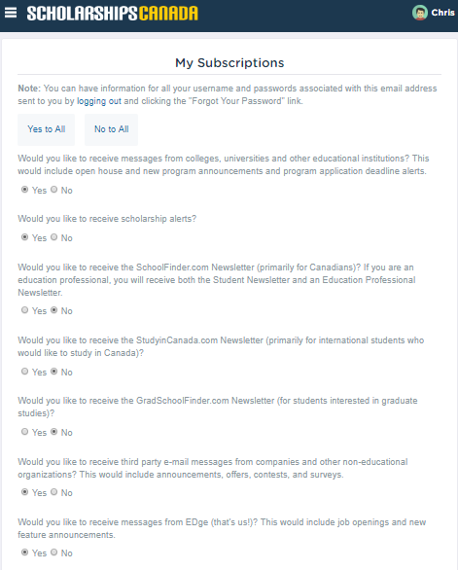
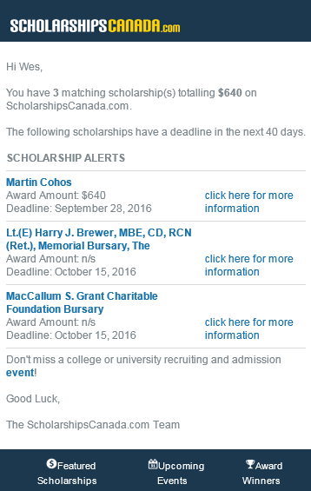

Manage your Subscriptions
Don’t forget to subscribe to receive scholarship deadline alerts!

Slide 26
Finding Scholarships: General Tips
Get motivated: You have to be willing to put in the time!
Invest your time: Try to dedicate a few hours per week
ScholarshipsCanada is your BFF: Keep your profile updated and sign up for scholarship deadline alerts
Understand the requirements: Don’t apply for awards you’re not eligible for. Have questions? Contact the award administrator
Notes:
Contacting admin = “demonstrated interest”

Slide 27
Finding Scholarships: General Tips
Apply to the smaller awards: There is a lot less competition!
Be prepared: Have reference letters, personal statements, cover letters or resumés on hand
Don’t give up: Don’t be discouraged if you don’t win the first three, five or ten awards that you apply for

Slide 28
Boilerplate Documents
Create a boilerplate: Basic template for your documents
Resumé (one page is all you need)
Personal statement (about 500 words)
References (two is a good number; one academic and
one personal)
Customize these docs for each award you apply to!

Slide 29
Personal statement basics
500 word personal statement. When in doubt, cover:
Who you are (what’s your background & history; how do you define yourself?)
What your goals are (what do you want to achieve? Where are you headed next?)
What receiving the award means to you (how will this scholarship impact you?)
What receiving the award means to your community (how will your win affect others around you?)

Slide 30
Scholarship FAQs
When should I apply?
After accepting an offer of admission; most scholarships will expect you to be enrolled, or at least accepted, to a college or university. Once you've accepted an offer of admission, you can start applying for most awards.
Are there awards for people in the trades?
Yes! Though they're not as common. Look for awards targeted at people in technology, construction, and other trades, apprentices, and awards aimed at the "diploma" or "certificate" level to find scholarships open to tradespeople.

Slide 31
Scholarship FAQs
How many scholarships can I apply to and receive?
As many as you like! There's no maximum for total scholarships received. Though specific organizations may specify that you can only receive one of their awards, that won't affect other organizations or scholarship admins.
What are the highest value scholarships?
Canada has relatively few "full ride" scholarships, though they do exist. Some of the biggest awards in the country include the Loran Scholarships, the TD Scholarships for Community Leaders, and the Schulich Leader Scholarships.

Slide 32
Scholarship FAQs
Can I defer a scholarship if I need to?
In some cases, yes, scholarship admins will let you defer the award. This is hit and miss: really depends on the admin. When in doubt, reach out.
Are there scholarships for international students?
Yes, though they’re less common than awards for domestic students (citizens and permanent residents). They’re often rather competitive, and typically focus more on grades than the other achievements we’ve discussed. Schools outside Canada will also award scholarships for internationals, but the same rules apply!

Slide 33
Scholarship Next Steps
In grade 11? Build your resumé
volunteer (meaning, not hours!), leadership, community service, grades
In grade 12? Apply for schools and awards!
entrance awards, awards for first-years and those just out of high school
In college/uni? Get involved with clubs and associations & check w/ financial aid office
find awards for second-years and above, department-nominated awards

Slide 34
Study and Go Abroad /
SchoolFinder Fairs
Come out to SAGA / SFF this fall! Four cities across Canada:
Calgary, Sept 27
Vancouver, Sept 28
Ottawa, Sept 30
Toronto, Oct 1

Slide 35




Q&A + Thank you!
We wish you the best of luck in your search!
Be sure to check out the next session! And we hope to see you at a Study and Go Abroad / SchoolFinder Fair!
(And visit us on social!)
/ScholarshipsCanada
@ScholarshipsCA
@ScholarshipsCanada
@ScholarshipsCanada

